Slide 1
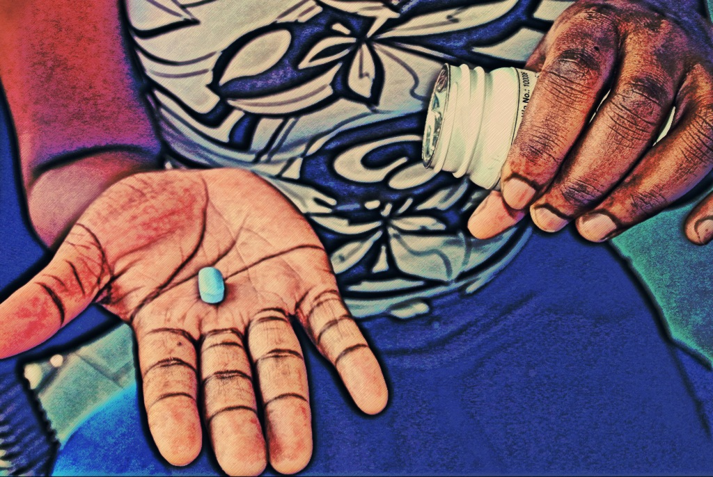
Pre-Exposure
Prophylaxis (PrEP) and HIV Drug Resistance
Training materials for healthcare workers
Notes:
Slides are generally directed towards the healthcare workers that will be collecting the DBS, or counseling on results. Trainers may choose to only use the slides that are relevant to the particular cadre of trainee.

Slide 2
Training Modules
Module | Training Topic | Slide Number
I | HIV and drug resistance | 3
II | Risk of drug resistance with PrEP | 11
III | Drug resistance testing among PrEP seroconverters | 17
IV | Dried blood spot collection steps with venipuncture | 22
V | Interpreting drug resistance test results | 35
VI | Counseling PrEP clients about drug resistance | 49

Slide 3
Module I:
HIV and Drug Resistance

Slide 4
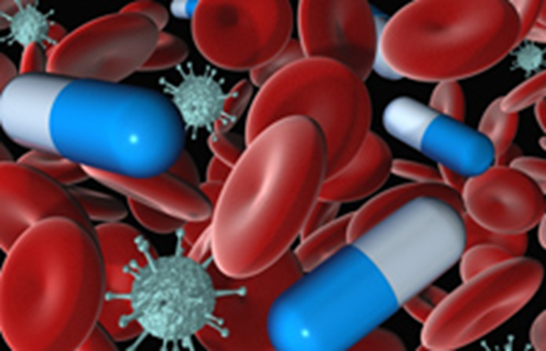
How Do ARVs Work?
When someone becomes infected with HIV, the virus begins to make copies of itself inside the body
Antiretrovirals (ARVs) are drugs that stop the virus from making copies of itself
A combination of 3 ARVs is usually needed to stop the virus from making copies

Slide 5
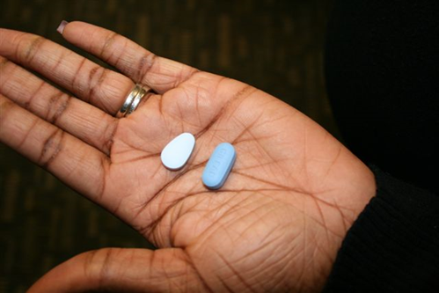
What Are Tenofovir And Truvada?
Tenofovir (1 drug) or Truvada (tenofovir + emtricitabine = 2 drugs in one pill) are currently being used as PrEP medications
Tenofovir and Truvada are also a part of the commonly used 3-drug ARV regimen to treat HIV
Tenofovir and Truvada alone:
  effectively prevent HIV infection if used correctly
  are not effective at treating HIV; full 3-drug ARV regimen is required to treat

Slide 6
What Happens When HIV Mutates?
Sometimes, the genetic material in the virus changes; these changes are called mutations
The mutated virus begins to make more and more copies of itself inside the person’s body
ARVs work best to treat what is called the “wild-type” (or non-mutated) virus
Because ARVs are less effective at stopping mutated virus from making the copies of itself, the proportion of mutated virus grows, leading to treatment failure
  this is called “acquired drug resistance”

Slide 7
What Is HIV Drug Resistance?
The ability of HIV to continue making copies of itself in the presence of ARVs is called HIV drug resistance
What does this mean?
The resistance will be to specific HIV drugs (not all types of ARVs)
These specific drugs will not be able to stop all of the HIV viruses from making copies
It often happens due to problems with adherence
A different combination of 3 drugs may be needed to treat HIV
If PrEP users develop resistance, they may have fewer choices of the ARV drugs that they can use for treatment (but they will still have options)

Slide 8
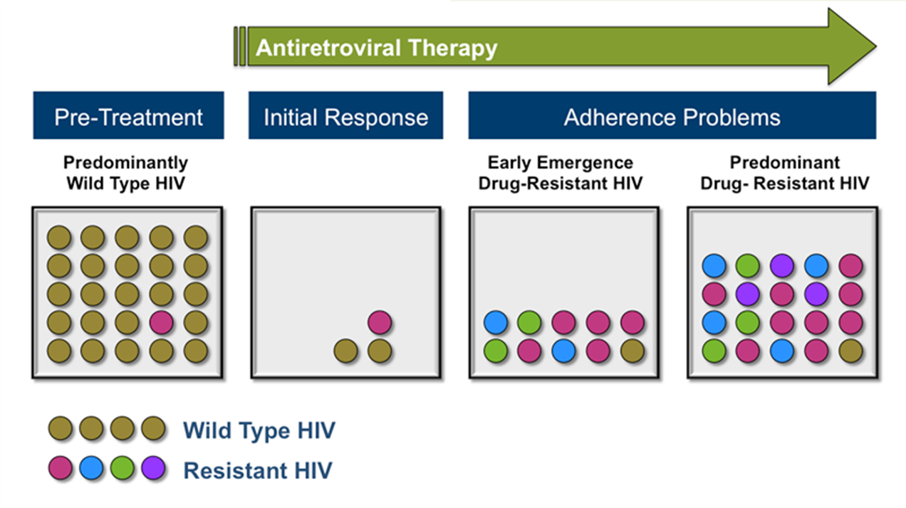
Acquired Drug Resistance: Impact of Adherence
Before a person with HIV starts ARV therapy (ART), they may have mostly “wild” type virus
Once they start ART, the amount of virus in their body decreases
If the person does not take their ARVs regularly, the virus in their body can mutate and become resistant to some ARVs
If the drug resistant virus continues to grow, the current ARV regimen will no longer be effective
*Figure from www.hivwebstudy.org

Slide 9
Are There Other Ways To Get Drug Resistant Virus?
YES
The person can get HIV from someone whose virus already mutated and became resistant to one or more ARVs. This is called “transmitted drug resistance.”

Slide 10

Why Is HIV Drug Resistance A Concern With PrEP?
Tenofovir and Truvada that are used for PrEP are also used in the “first-line” ARV treatment regimen — that is providers’ first choice of ARV drugs for treating HIV (commonly two NRTIs and a NNRTI).
If an HIV-positive client develops resistance to tenofovir or Truvada, the provider has to:
  find another first-line combination of ARVs that may be effective against the mutated virus OR
  switch to a second-line regimen (commonly 2 NRTIs and a ritonavir-boosted PI)
It is important to reassure clients with resistant virus that there are still treatment options

Slide 11
Module II:
Risk of Drug Resistance with PrEP

Slide 12




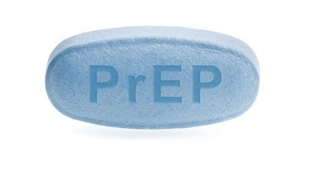


Drug Resistance Scenarios While On PrEP
A person with HIV transmits drug resistant virus to HIV-negative partner who takes PrEP
PrEP does not protect against the resistant virus
PrEP user becomes infected with drug resistant HIV
A person starts taking PrEP during acute HIV infection (before HIV test turns positive)
Keeps taking PrEP until she/he gets a positive rapid test result
HIV becomes drug resistant
HIV-negative person takes PrEP
Becomes infected with HIV, but keeps taking PrEP until she gets a positive rapid test result
HIV becomes drug resistant
Less likely scenario
(if PrEP is taken correctly)

Slide 13


How Could Someone Take PrEP And Not Know They Were Infected?
By not getting tested for HIV, a PrEP user may not be aware that she/he has become infected
    This is why it is important for PrEP users to get tested at the frequency recommended by the program
If a person was recently infected, the HIV test might not have detected the infection because of the window period of the test
    This is why it is important for providers to assess for symptoms of acute HIV infection before providing PrEP

Slide 14
PrEP and Drug Resistance: Scenario
A client is taking Truvada as PrEP. Because she was very busy for the last few months, she had a hard time remembering to take PrEP regularly and became infected with HIV.

Slide 15
PrEP and Drug Resistance Scenario: Outcome #1
She returns to the clinic for her routine HIV test within a month of her seroconversion. She learns right away that she is positive, so the PrEP provider informs her to stop using the PrEP medications.
Because she stopped using the PrEP medication so quickly, the HIV virus did not become resistant to Truvada, as confirmed by her resistance test result.
She is referred to the ART clinic and initiates first-line ARV treatment regimen, which includes Truvada.

Slide 16
PrEP and Drug Resistance Scenario: Outcome #2
She misses her next clinic visit and continues taking Truvada as PrEP inconsistently. She returns to the clinic for PrEP refill and an HIV test approximately 6 months after her seroconversion. Her resistance test results show high levels of resistance to Truvada.
Because she continued using the PrEP medication after seroconversion, the virus became resistant to Truvada.
She is referred to the ART clinic and initiates 2nd line treatment regimen, which doesn’t include Truvada.

Slide 17
Module III:
Drug Resistance Testing Among PrEP Seroconverters

Slide 18
Drug Resistance Testing Rationale
For the individual client and provider:
Drug resistance test results will guide treatment options, including recommendations to initiate 2nd line regimen if needed
For the policy maker:
Analyzing drug resistance test results across all PrEP users who become HIV infected will provide important information about:
  the effectiveness of the national PrEP program and whether additional client support may be needed for PrEP adherence and/or routine HIV testing
  whether the frequency of HIV testing is adequate to capture seroconversions as quickly as possible
  changes in overall rates of HIV drug resistance in the country

Slide 19
Drug Resistance Testing In PrEP Seroconverters
What
Blood for a dried blood spot (DBS) sample will be collected using venipuncture
Client’s demographic and adherence data will be collected using a brief data collection form

Slide 20
Drug Resistance Testing In PrEP Seroconverters
When
Blood for DBS will be collected upon identification of seroconversion
If blood is not collected on the day of seroconversion confirmation, clients should be asked to return as soon as possible to complete the procedure
Results will be returned to the clinic as soon as possible (time will vary based on location)
Notes:
Drug resistance testing turnaround time should be updated as per local laboratory guidelines/processes.

Slide 21
Drug Resistance Testing In PrEP Seroconverters
Where
DBS sample collection will be done at the clinic
Drug resistance testing will be done at a centralized laboratory
The centralized laboratory will not have any identifying information about the client
  the sample and results will be tracked only by a barcode
Results will be provided to the clinic that collected the sample in a form of the report listing identified mutations and affected drugs

Slide 22
Module IV:
Dried Blood Spot Collection with Venipuncture

Slide 23

Step 1: Obtain Informed Consent [if required by program]
After confirming HIV infection with PrEP client, review consent for DBS collection.
If consent is obtained, continue.

Slide 24
Step 2: Complete Data Collection Form
Complete the data collection form to record client’s demographic and adherence data.
Notes:
Data collection form should be updated per program’s data collection needs – this is an example of key items to collect.

Slide 25
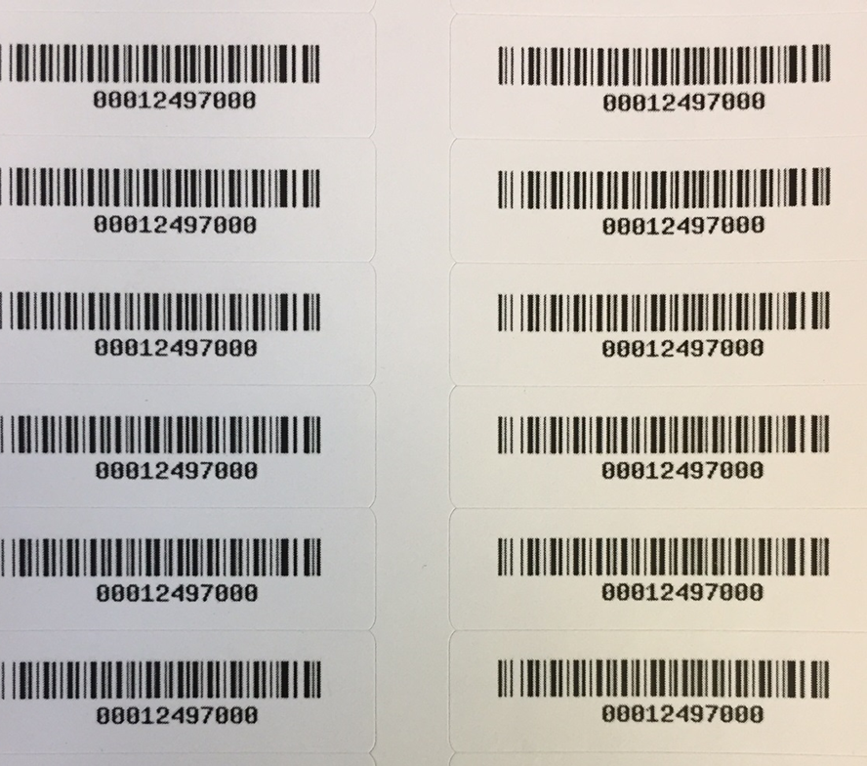
Step 3: Affix Barcode Labels
Remove barcode labeled stickers and affix stickers to:
Two DBS cards
Data collection form
Client’s medical file
Blood collection tube
Notes:
If code is placed in medical file, this will allow for results to be returned to client. This should be updated per program’s needs/design.

Slide 26
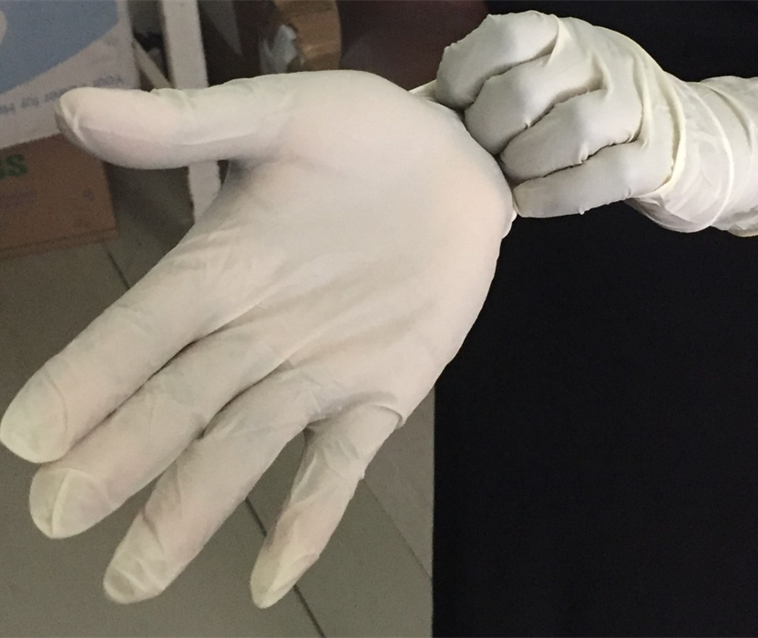
Step 4: Wash Hands And Put On Gloves
The clinician will wash his/her hands with soap and water, and then put on well-fitting gloves
  non-sterile gloves are sufficient

Slide 27
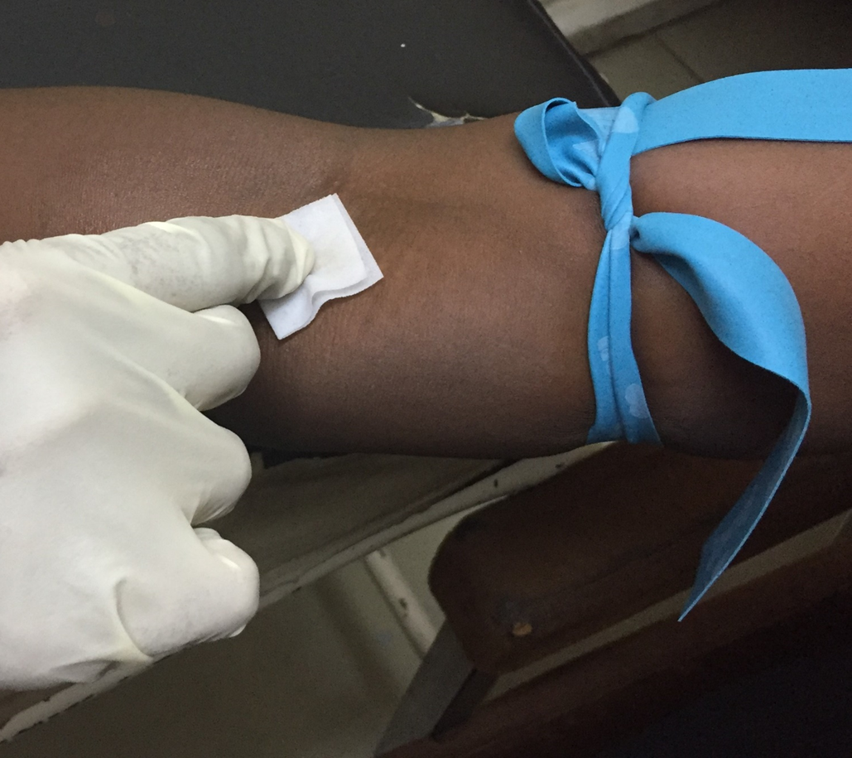
Step 5: Apply Tourniquet And Wipe Puncture Site
Apply a tourniquet 3-4 inches (8-10 cm) above the puncture site
Wipe the puncture site with the alcohol wipe. Allow the site to air dry for 30 seconds

Slide 28
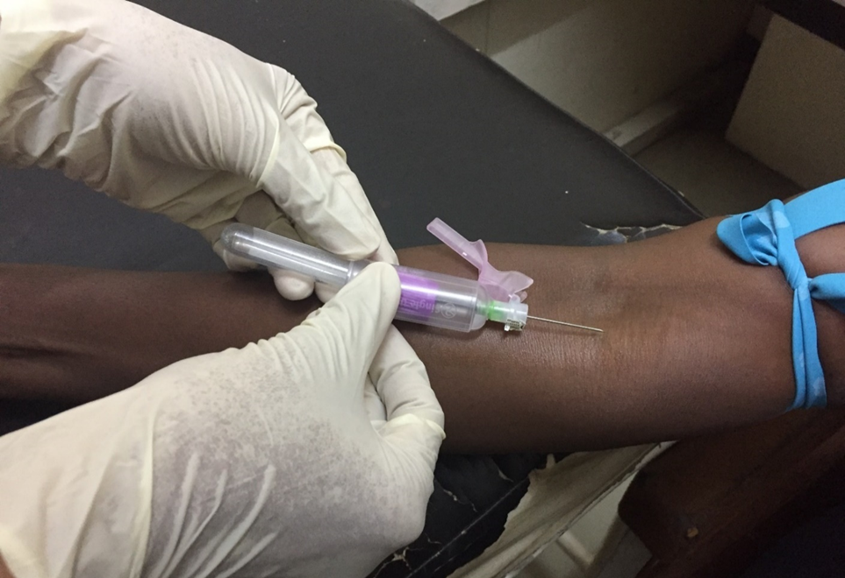
Step 6: Collect Blood
Anchor the vein by placing a thumb BELOW the venipuncture site
Guide the needle into the vein at a 30 degree angle and fill the connected EDTA blood collection tube
Once done:
  release tourniquet
  withdraw needle
  apply a gauze pad to site
  apply Band-Aid as needed

Slide 29
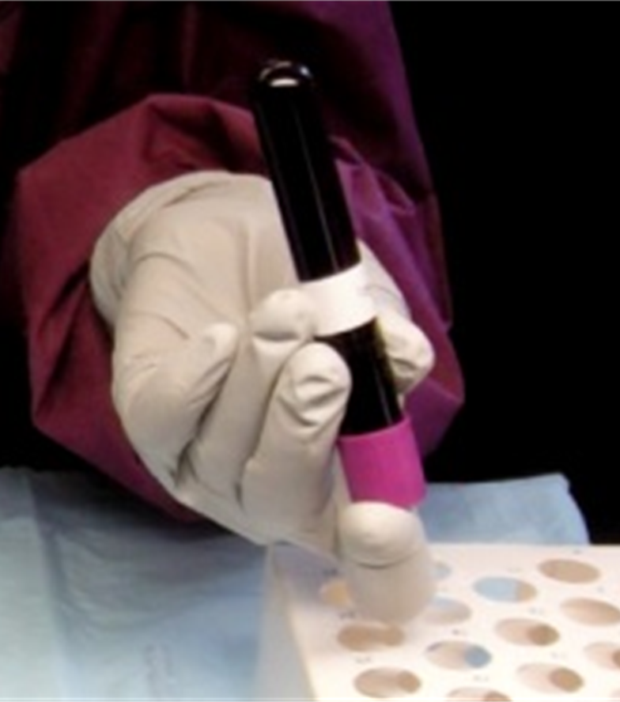
Step 7: Invert The Tube
Gently invert the blood collection tube gently 2 to 4 times to mix anti-coagulant (EDTA) additive with the blood
Then open the stopper carefully

Slide 30
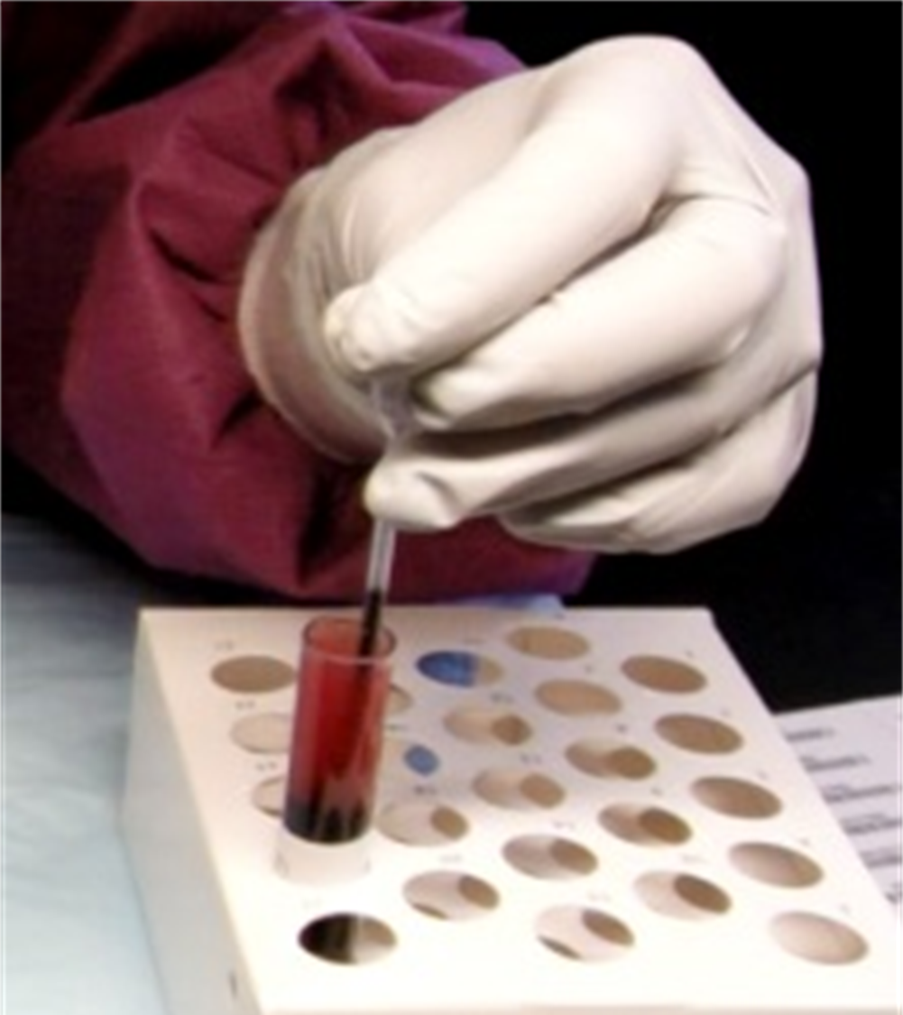
Step 8: Aspirate Blood
Aspirate whole venous blood using a transfer pipette
  avoid air bubbles
It takes 1 to 2 drops of blood per circle (or 50μL–100 μL)

Slide 31
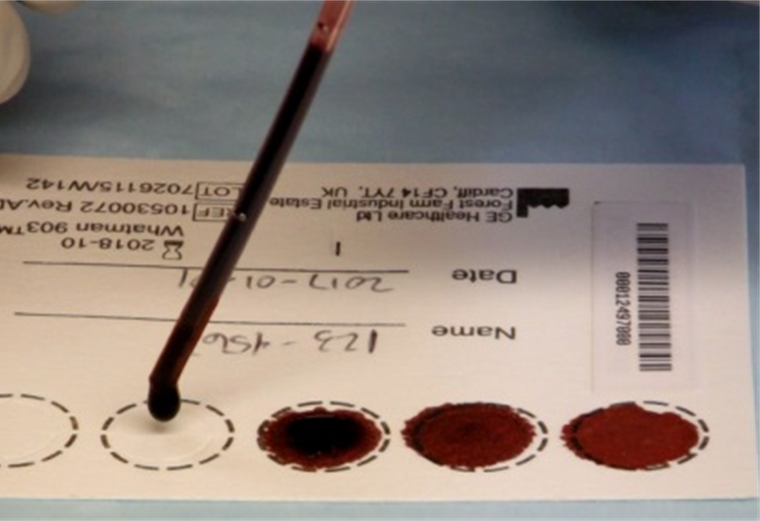
Step 9: Transfer Blood To Two DBS Cards
Transfer 1-2 drops of the blood to the center of each circle without touching the filter paper directly with the tip of the pipette
Fully saturate the entire circle
Complete all five circles on each of the two DBS cards
Avoid touching and smearing the blood spots

Slide 32
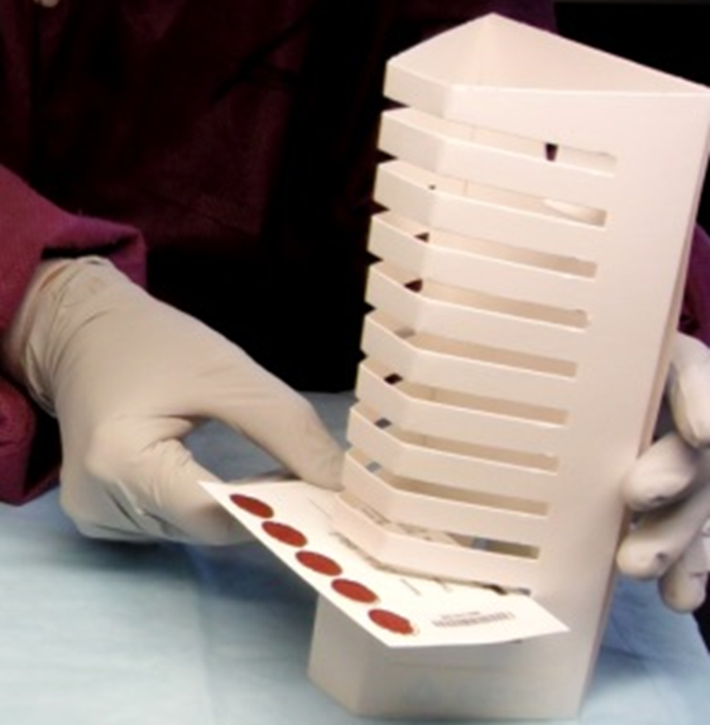
Step 10: Drying DBS Cards
Do not stack or allow DBS to touch other surfaces during the drying process
Keep away from direct sunlight
Dry DBS cards, with the blood facing up, on the drying rack at room temperature for a minimum of 3 hours (preferably overnight)
The blood color on the DBS cards will change from bright red to dark red as it dries

Slide 33
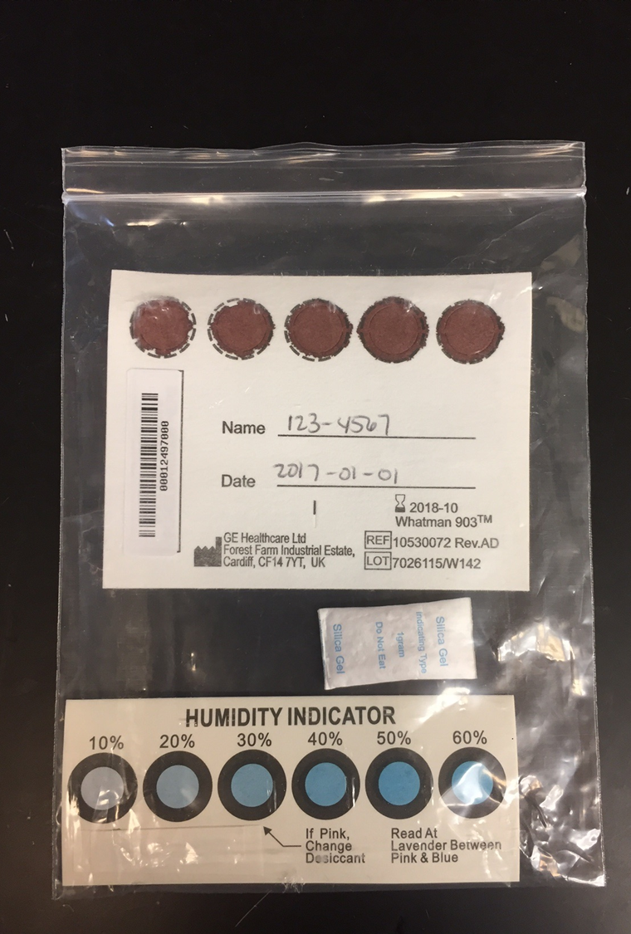
Step 11: Packaging DBS Cards
After the DBS cards dry, insert both into the sealable plastic bag with the desiccant pack(s) and humidity indicator
  up to 5 desiccant packs may be needed, depending on environmental conditions
Avoid using bags that are too big as the cards will shuffle inside the bag

Slide 34
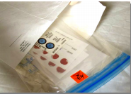
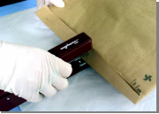
Step 12: Prepare For Shipment
Place a label on the outside of the sealable plastic bag indicating bio-hazardous contents
Put the sealable plastic bag and data collection form into a rip-resistant envelope and then into brown shipping envelop and seal for shipment.
Mail the envelope as soon as possible, but within 3 days

Slide 35
Module V:
Interpreting Drug Resistance Test Results

Slide 36
Getting The Result Back From The Lab
Drug resistance test results take on average 2 weeks, but the time it gets to the clinic may vary depending on setting
By the time test results are available, the client may or may not have started ART
Clinic staff will retrieve the result and confirm client identification using the barcode sticker
The clinician or other trained staff will either:
  counsel the client on his/her results and their implications for future treatment
  forward the results to the client’s ART provider

Slide 37
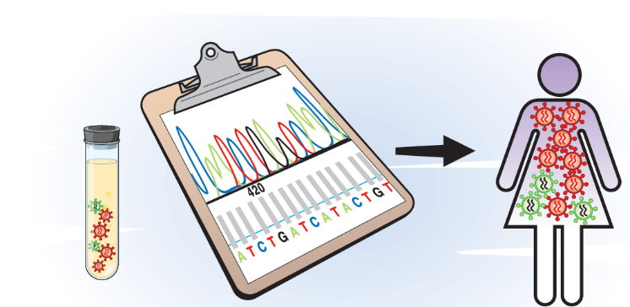
What Does a Drug Resistance Test Measure?
A drug resistance test identifies presence of HIV mutations that have been linked to resistance to ARVs

Slide 38
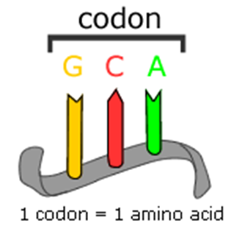
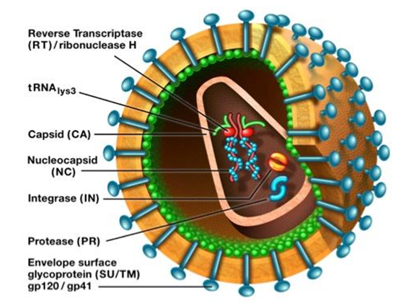
Understanding Terminology: Codon, RT and PR
Codon: a sequence of three building blocks (nucleotides) that corresponds with a specific amino acid. A “chain” of codons makes up viral genetic code
Reverse transcriptase (RT) and protease (PR): viral enzymes, in which genetic code is analyzed in order to detect mutations that are known to result in drug resistance.

Slide 39
Understanding Terminology: Major vs. Minor Mutations
Major mutations:
Commonly occur during virologic failure (when ART fails to adequately suppress a viral load)
Located at structurally important parts of a viral protein
Reduce susceptibility to one or more ARV
Minor mutations:
Commonly occur in untreated patients as natural variants
Are rare or emerge later, after other drug-resistance mutations occurred
Have little or no effect on susceptibility to ARVs

Slide 40
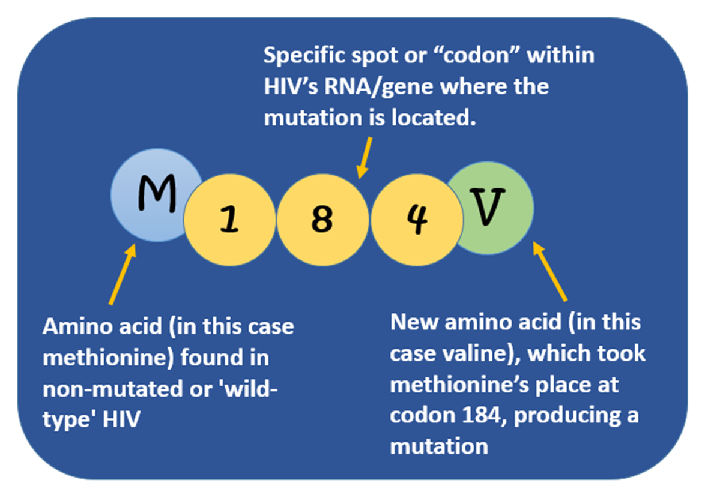
Understanding How To Read Mutations
Scientists use a letter and number to describe HIV’s genetic material
The NUMBER shows where the mutation occurred.
The LETTER shows how it changed.
M184V -- a mutation in the reverse transcriptase (RT) gene that causes resistance to 3TC (lamivudine)

Slide 41
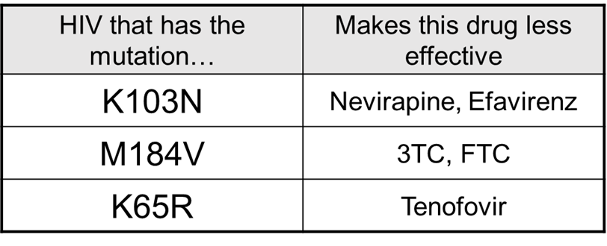
Why Is This Terminology Important?
These letters and numbers will be on the client’s drug resistance report
The mutation pattern will:
  let the healthcare workers know which drugs the client is resistant to
  help the ART provider to decide which drugs to prescribe to the client to treat his/her HIV infection

Slide 42
Can HIV Have More Than One Mutation?
YES
HIV can be resistant to one
drug or multiple drugs
NO

Slide 43
How To Interpret HIV Drug Resistance Results
The results will indicate which ARVs have reduced effectiveness
Each HIV drug has its own resistance result, which can be:
SUSCEPTIBLE
INTERMEDIATE RESISTANCE
HIGH LEVEL RESISTANCE

Slide 44
What Do The Drug Resistance Results Mean?
SUSCEPTIBLE | There is no evidence of resistance to this ARV
INTERMEDIATE RESISTANCE | There is some evidence of resistance but it may not have been validated or clinically verified
HIGH LEVEL RESISTANCE | This ARV’s effectiveness is significantly reduced

Slide 45
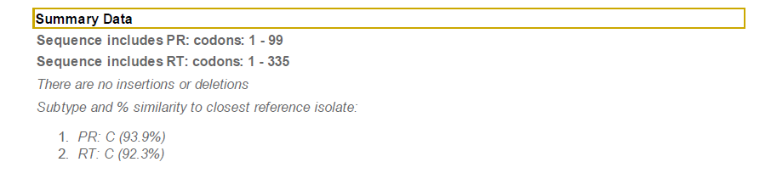
What Is In The Drug Resistance Report?
The percentage tells how closely the person’s virus matches a known subtype.
The Summary Data identifies the subtype.
This client is infected with SUBTYPE C HIV-1.
Notes:
Note: results report should be updated as appropriate to the setting, and align with country guidelines for treatment.

Slide 46
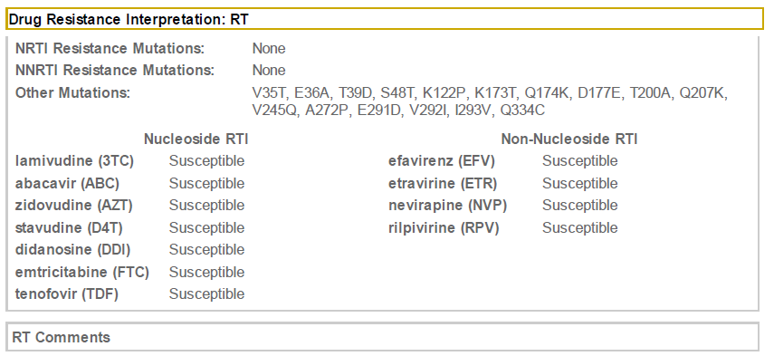
What Is In The Drug Resistance Report (continued)?
RT mutations affect resistance to drugs in the NRTI and NNRTI class (first-line ART)
The report shows this client does not have RT-based drug resistance and can be treated with the first-line ARV regimen.
Notes:
Note: results report should be updated as appropriate to the setting, and align with country guidelines for treatment.

Slide 47
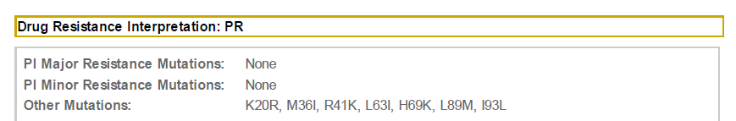
What Is In The Drug Resistance Report (continued)?
Protease Inhibitors (PR) are usually part of the second-line ARV treatment regimen
PR mutations may not be relevant as long as there are valid options for the first-line treatment regimens
Knowing both, RT and PI mutations is important when making a decision if/when switching to a second-line ARV regimen is warranted
Notes:
Note: results report should be updated as appropriate to the setting, and align with country guidelines for treatment.

Slide 48
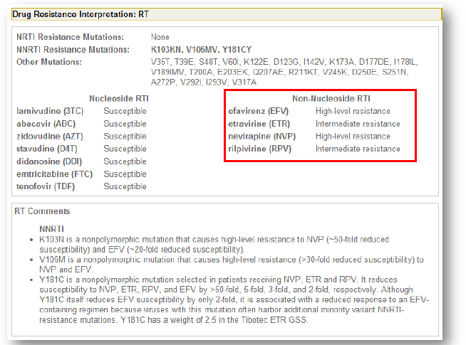
What If There Is Resistance Found?
The specific mutations causing the resistance and what drugs are affected will be shown.
The comments may help the doctor who is prescribing therapy to have more information about the specific kind of resistance.
Only the client’s clinician can decide which ARVs the client should take
Notes:
Note: results report should be updated as appropriate to the setting, and align with country guidelines for treatment.

Slide 49
Module VI:
Counseling PrEP Clients About Drug Resistance

Slide 50

Client Counseling
Maintain respectful attitude and show acceptance
Avoid:
  being judgmental
  arguing, confronting, and pressuring the client into action
Employ good counseling skills, such as asking simple open-ended questions, using active listening, paraphrasing and reframing

Slide 51

Client Counseling (continued)
Provide counseling on the outcome of client’s resistance test and explain:
  what test shows
  impact on treatment
  next steps

Slide 52

Tips for Resistance Counseling When Providing Results
Resistance can be hard to understand. It is important to:
  assess client’s understanding
  encourage client to ask questions
If a client’s test results show resistance, explain:
  there are different degrees of resistance
  resistance to a certain ARV does not automatically mean that one can no longer use it
  even when a certain ARV is not effective due to resistance, other treatment regimens exist

Slide 53

Additional Tips for Resistance Counseling
While on PrEP:
Emphasize the importance of taking medication as instructed
Explain importance of adherence in preventing resistance
Build client’s skills for adherence to PrEP:
  identifying approaches to improve adherence
  discuss a realistic, doable plan
In case of seroconversion:
Provide referrals and explain their importance
Follow up on referral completion

Slide 54
Minimizing Risk of Resistance: Key Counseling Points
Avoid Getting HIV: Use PrEP consistently and correctly while at-risk of acquiring HIV. Resistance to ARV drugs cannot occur in a person who does not have HIV.
Attend Clinic Visits: HIV testing will be done quarterly. If testing shows that a person has become infected with HIV, PrEP should be stopped immediately to avoid developing drug resistance.
AVOID
ATTEND

Slide 55
Minimizing Risk of Resistance: Key Counseling Points
Do Not Share PrEP: Sharing PrEP with other people, even with a partner, could be harmful. They could have HIV, and not know it. If a person with HIV use PrEP, this could cause resistance to ARV drugs.
PrEP works if you use it: The benefits of PrEP are greater than the risk of resistance. But minimizing the risk will help to limit the potential impact on HIV treatment.
DO NOT
SHARE
PrEP
WORKS!

Slide 56

What If I Need Help?
For help with DBS collection procedures, counseling messages, or interpreting the drug resistance outcome report, contact: (insert appropriate contact information here)

